Slide 1
Ministry of Education and Sciences of Georgia
National Center of Teacher Professional Development
( NCTPD)
Novice Teacher Induction Program
in Georgia 2011-2012
Eka Mamatsashvili
Program Coordinator
2-6 November, 2011
Latvia

Slide 2
NCTPD Mission
Enhance teaching and learning through supporting development of subject knowledge and instructional skills of teachers

Slide 3
Main Areas of activity
Trainings - Assure professional development of acting teachers
Programs- Attract qualified individuals to school, support their professional development and retain in teaching

Slide 4
NCTPD involved in
Teacher Certification
Teacher Professional Standards
Inclusive Education
ICT Trainings
“Teach for Georgia”
“Learn and Teach Georgian”
Novice Teacher Induction State program

Slide 5
Complementary resources for teaching

Slide 6
The Teacher

Slide 7
Novice Teacher Induction and Mentoring in Georgia Pilot Project 2008 -2010 Lay foundation for the development of a novice teacher induction system in Georgia Identify major trends in relation with a novice teacher induction Motivate novice teachers to stay in the profession by providing mentor guidance in acquiring practical teaching skills

Slide 8
Project Implementation and Participants
Six major cities of Georgia
98 Inductees - newly qualified subject teachers
58 mentors - qualified and experienced teachers of different subjects
24 public schools

Slide 9
Major Results of the Pilot Project
Assistance to novice teachers gain experience and motivation to pass teacher certification exams
Supported new teachers to get recruited in case of successful induction period -1/3 of new teachers employed
Increased awareness on the necessity of mentoring and novice teacher induction on different levels
as teachers

Slide 10
Mentor Manual
Novice Teacher Manual

Slide 11
Pestalozzi Seminar July, 2009
“Mentoring novice teachers-innovative practices and approaches “
Get more knowledge and share experience on implementing novice teacher induction and mentoring

Slide 12
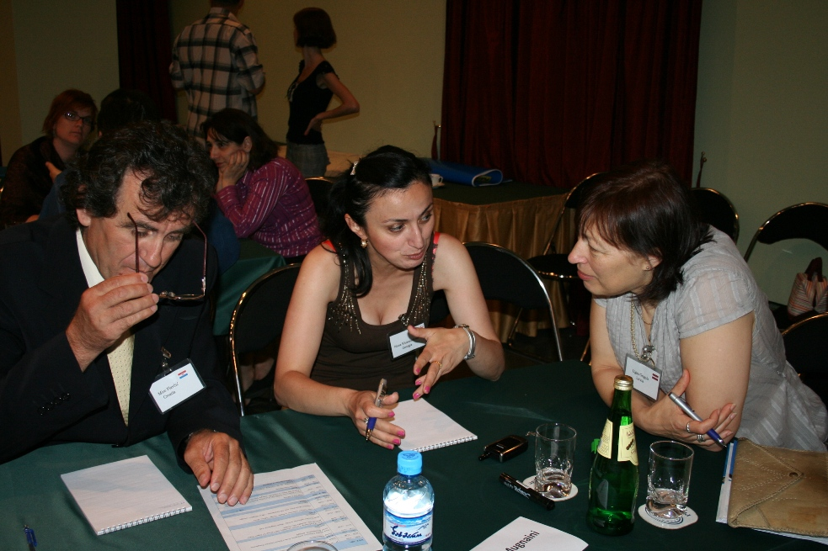

Slide 13
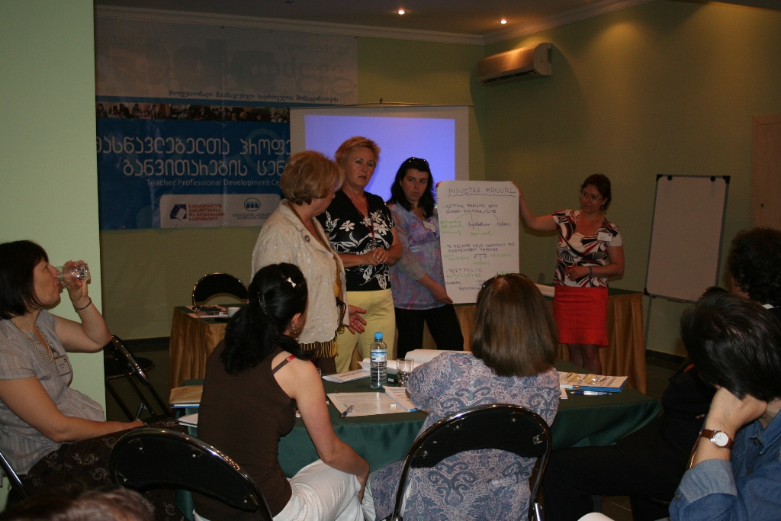

Slide 14
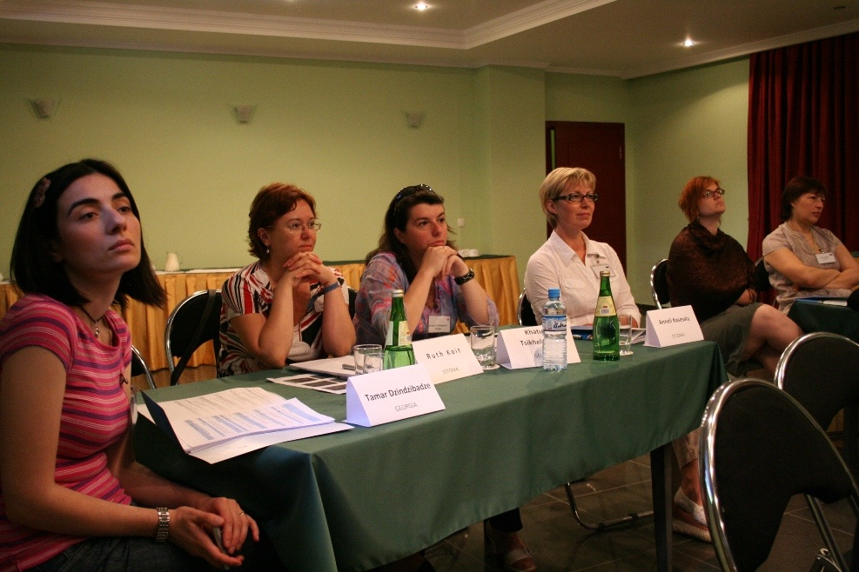

Slide 15
Aims and objectives of the state Program
Institutionalize the novice teacher induction and mentoring system in Georgia
Increase the number of schools, mentors and inductees
Develop the comprehensive Induction standards
Develop a flexible tool for the recruitment of successful inductees

Slide 16
New Approach to Mentoring -2010
Obligatory requirement for mentoring – only certified teachers allowed to become mentors
First teacher certification exams in Georgia– held in July 2010 in Georgian , Math and Foreign Languages (English, French, German and Russian)

Slide 17
Training of Mentors General Overview on mentoring and induction models worldwide Developing mentoring skills in adult learning and positive communication to novice teachers Developing report writing skills – needs analysis, inductee programs

Slide 18
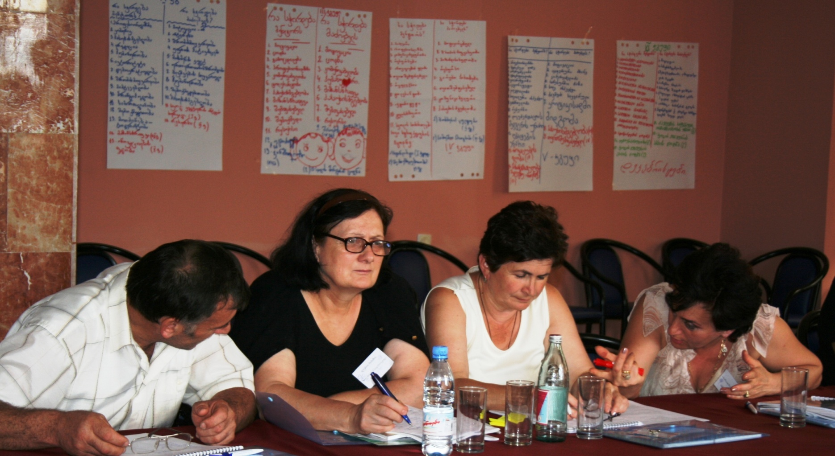
Steps to Success

Slide 19
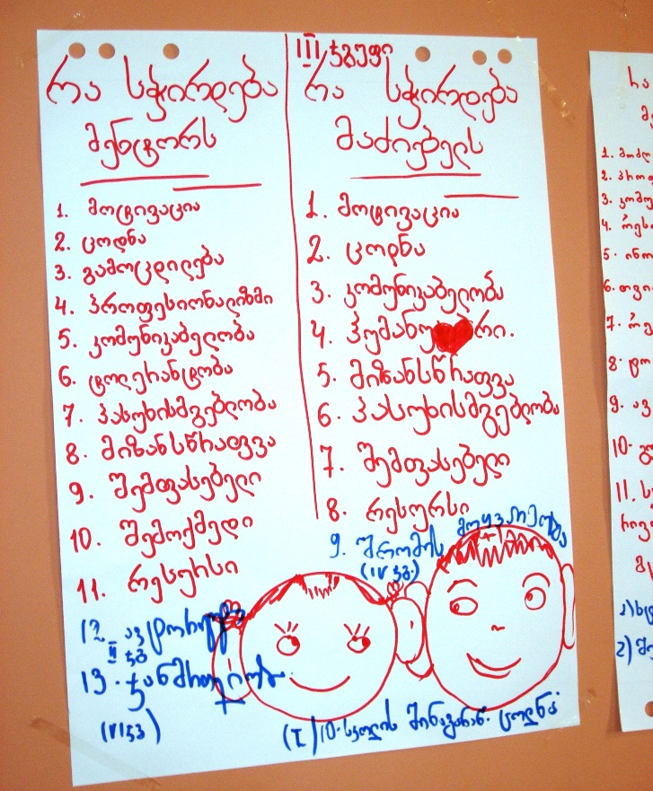

Slide 20
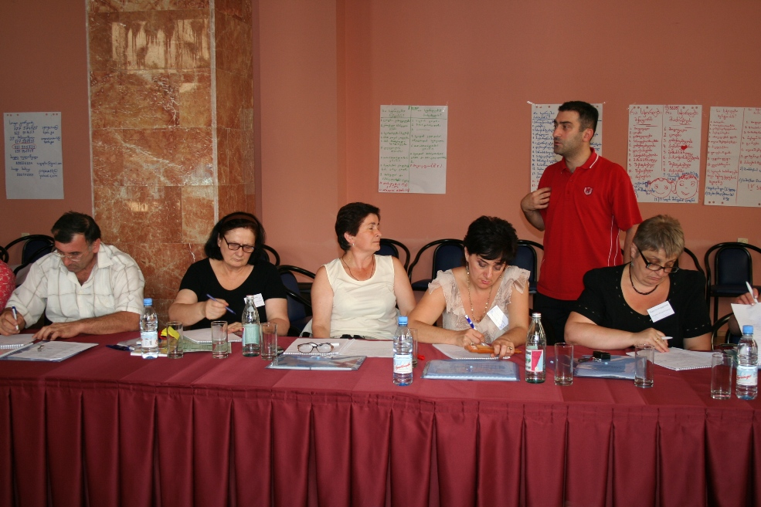

Slide 21
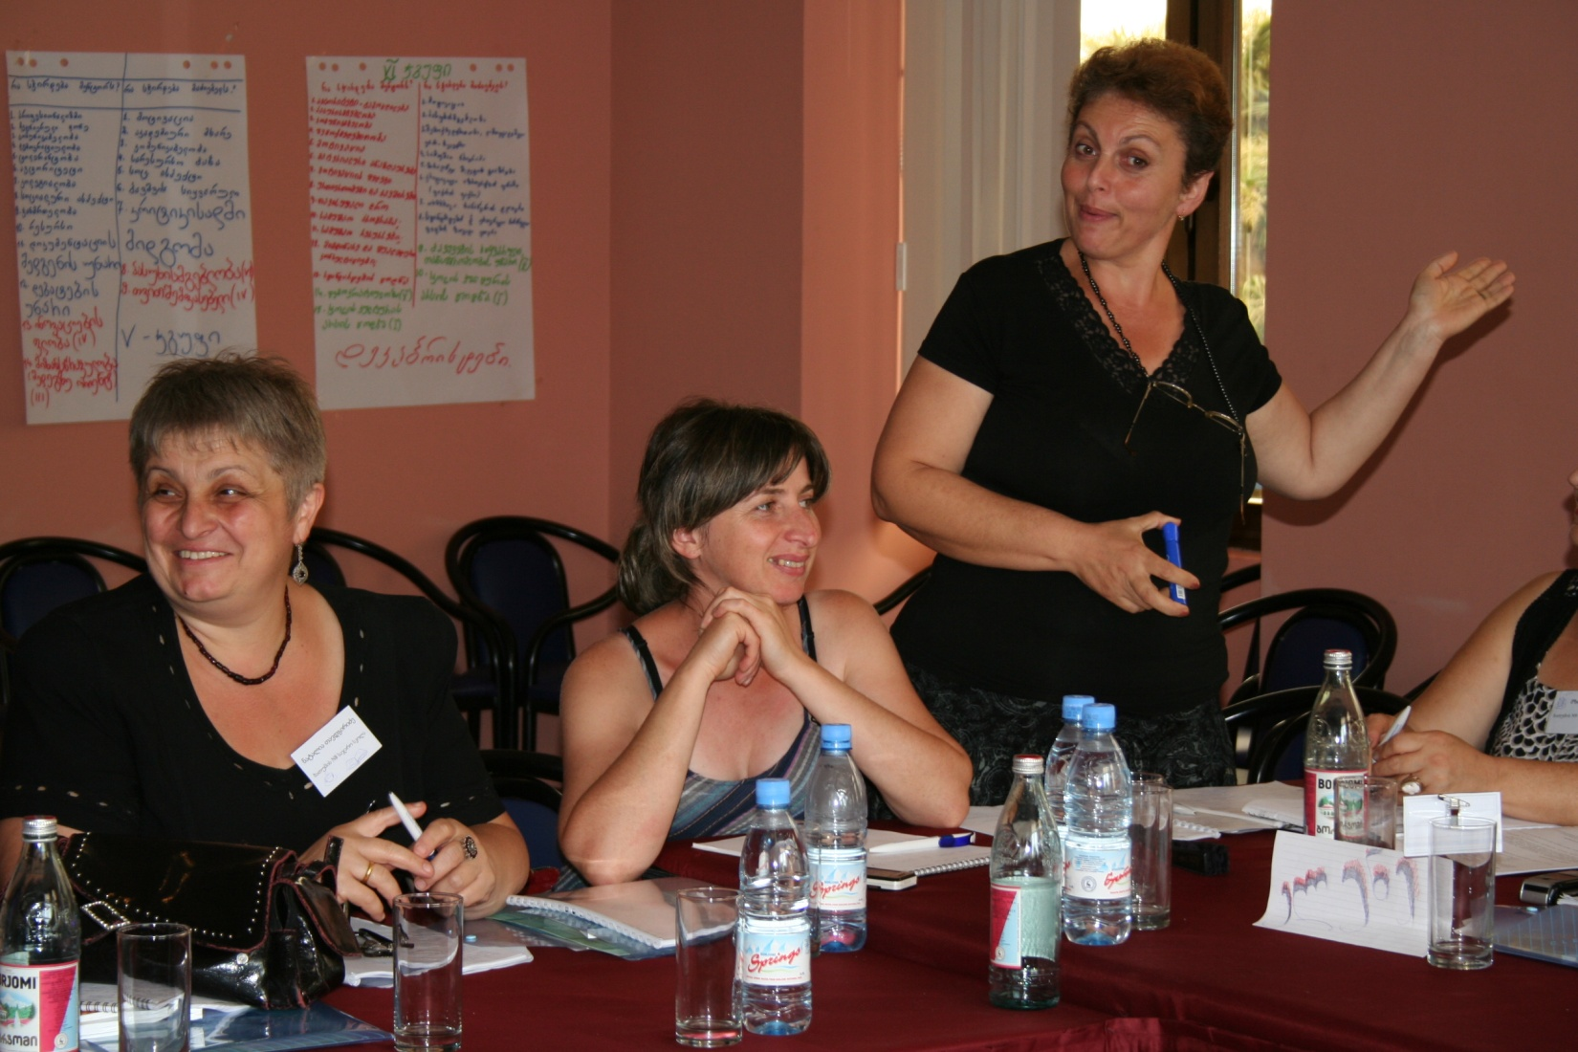

Slide 22
Novice Teacher Trainings

Slide 23
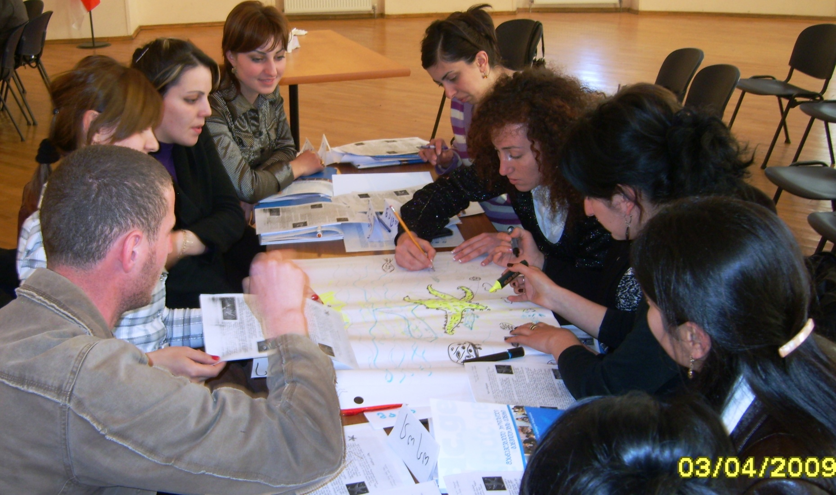
Steps to Success

Slide 24
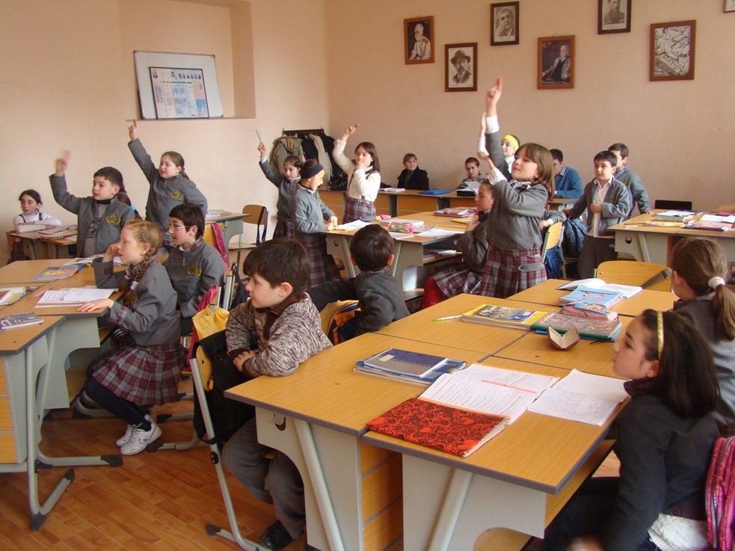

Slide 27
Program in Figures
10 cities in six regions of Georgia
90 public and private schools throughout Georgia
136 mentors – certified teachers of different subjects
1187 inductees –inexperienced subject teachers

Slide 28
For additional information, please visit our webpage at
WWW. TPDC.GE

Slide 29
Thank you!

